Slide 1
Smart Incubator
Engin Bajrami
Kevin Andoni

Slide 2
How could we use this knowledge to improve our lifes
The 1.st idea that struck us after starting the CMPT course this semester was:

Slide 3
Then, after messing around for days with our electronics at the dorms we got a second idea:
We could use our knowledge to create a Smart Incubator

Slide 4
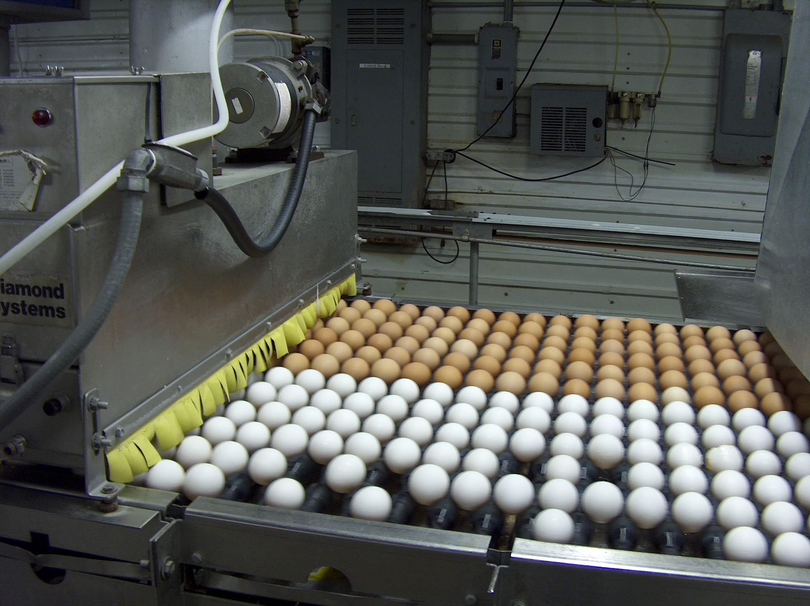
Purpose
The main predicted implementation of this project is as an embedded system in the industry of poultry hatchery.

Slide 5
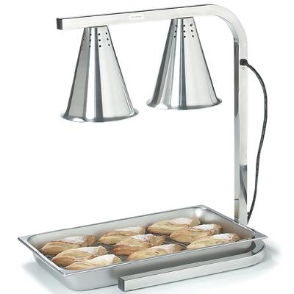
Components
Warming Lamp

Slide 6
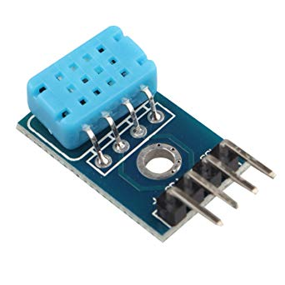
DHT12 Sensor

Slide 7
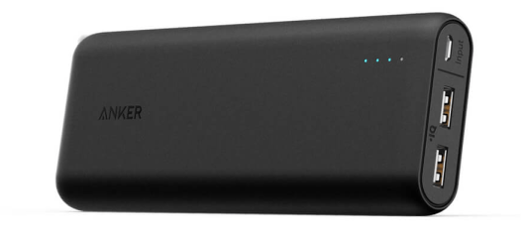
Powerbank

Slide 8
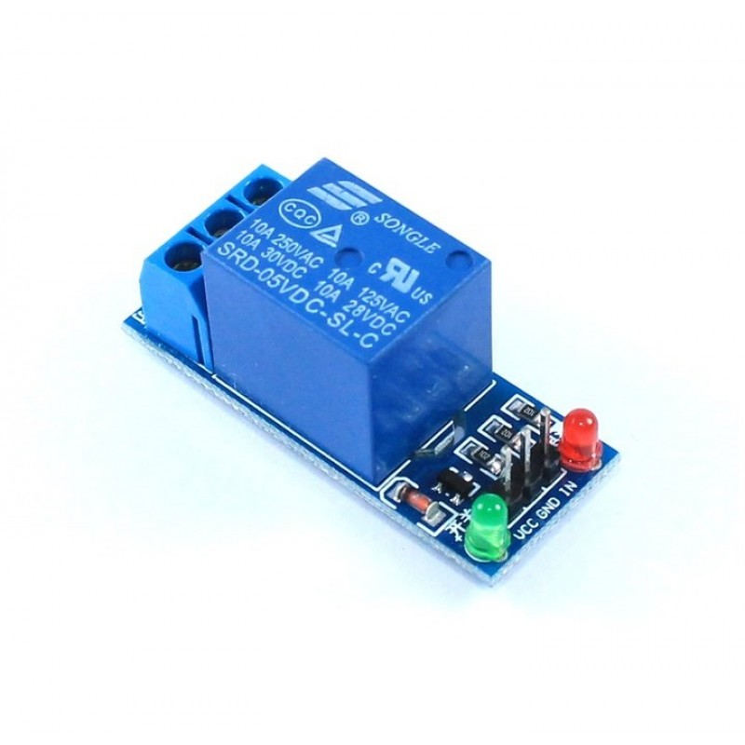
5V Relay switch

Slide 9
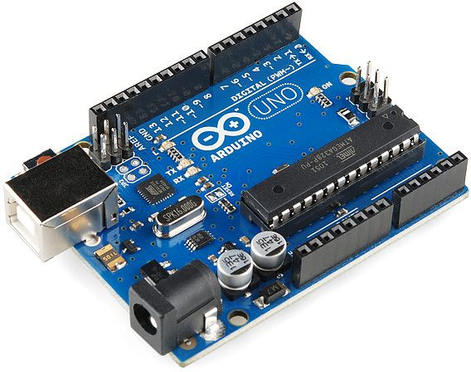
Arduino

Slide 10
Combining all the components together and adding some amount of coding gives gives us:
This Result

